Slide 1
Market Supply Analysi
Understanding Vegetable Price Trends and Supplier Sales

Slide 2
Price Analysis of Different Vegetables Across Seasons
Prices tend to rise during late summer and early monsoon seasons.
Onions experience high prices during autumn.
Most vegetables thrive in temperatures between 25-35°C.

Slide 3
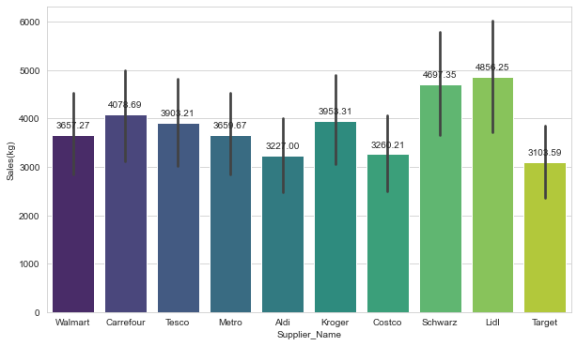
Supplier Sales Insights
Lidi boasts the highest sales of 4865.25, followed by Shwarz with 4697.35.
Highlight Target as the supplier with the lowest sales.

Slide 4
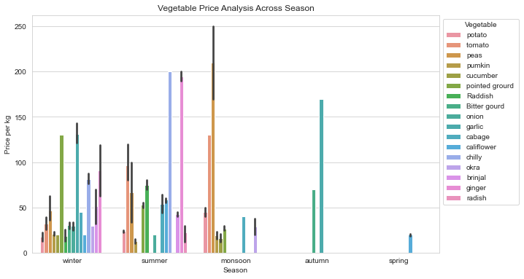
Seasonal Sales Analysis
Sales increase from the 5th to 15th month.
A gradual decrease in sales is observed from the 20th to 30th month.

Slide 5
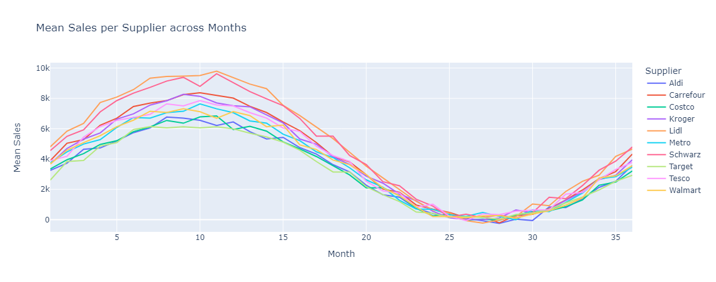
Supplier Sales Comparison

Slide 6


